Slide 1
construction INSURANCE prediction
By: Yinyi Du
GitHub: https://github.com/yd69341n/capstone-project

Slide 2
Research Questions
Can predict if a building will have an insurance claim during a certain period or not in Lagos and Nigeria?
Can predict the probability of having at least one claim over the insured period of the building in Lagos and Nigeria? If not, what factors will increase the probability of having the claim?

Slide 3
Motivation
Predict whether building collapse or damages will happen during the period of insurance
Prevent losing of lives
Help insurance company to increase profits

Slide 4
Literature review
Reference: https://ieeexplore.ieee.org/Xplore/home.jsp
Goal: Built a new insurance demand model to predict more accuracy insurance claims for individuals and improve the accuracy of insurance cost by using health data
Methodology: Used multiple regression algorithms such as linear regression, random forest regression, decision tress regression and support vector regression to build the model
Result: The age and smoking history had significant impact on the model. Premiums were determined by a person's health condition.

Slide 5
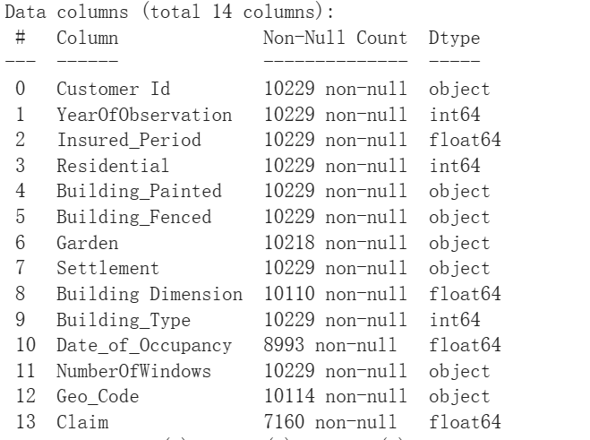
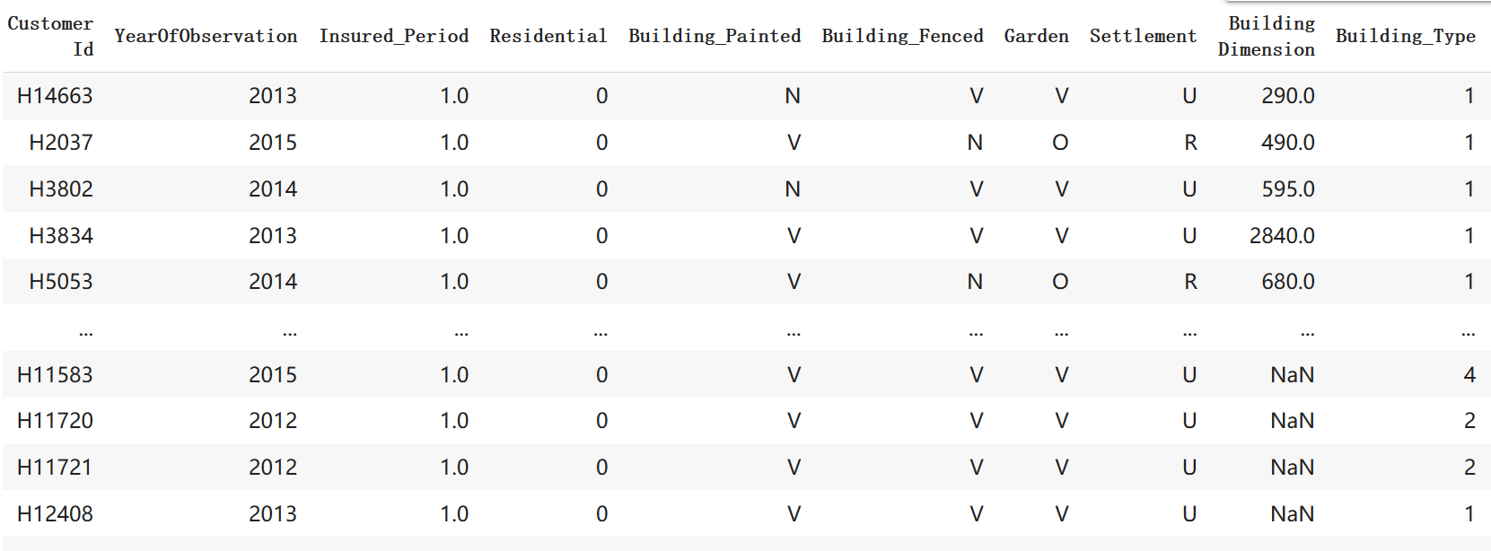
Dataset
Insurance Prediction
Dataset from Zindi:
https://zindi.africa/competitions/insurance-prediction-challenge/data
Dataset:
Insurance data from 2012-2016
Contains 10k rows and 14 columns

Slide 6
Dataset
Insurance Prediction
Dataset Variables:
Customer Id-Identification number for the Policy holder
YearOfObservation-year of observation for the insured policy
Insured_Period-duration of insurance policy in Olusola Insurance
Residential-is the building a residential building or not?
Building_Painted-is the building painted or not (N-Painted, V-Not Painted)
Building_Fenced-is the building fence or not (N-Fenced, V-Not Fenced)
Garden-building has garden or not (V-has garden; O-no garden)
Settlement-Area where the building is located. (R- rural area; U- urban area)

Slide 7
Dataset
Insurance Prediction
Dataset Variables:
Building Dimension-Size of the insured building in m2
Building_Type-The type of building
Date_of_Occupancy-date building was first occupied.
NumberOfWindows-number of windows in the building
Geo Code-Geographical Code of the Insured building
Claim-target variable. (0: no claim, 1: at least one claim over insured period).

Slide 8

Data Preprocessing
Data consists of both categorical and numerical data
Sorted the data by customer ID and deleted duplicate records based on customer ID
Categorial columns such as “Building_Painted”, “Building_Fenced”, “Garden”, “Settlement” were replaced by full text
Removed punctuation from “NumberOfWindows”
Converted “Building Dimension” and “'Date of occupancy” from float to int for further analysis

Slide 9
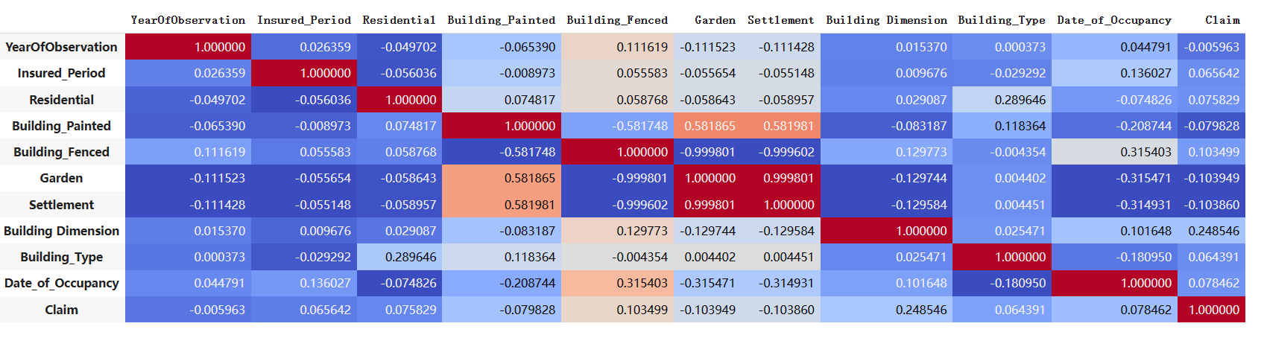
EDA-Some Meaningful insights
Bivariate and Multivariate Analysis:
Correlation of independent variable with target variable

Slide 10
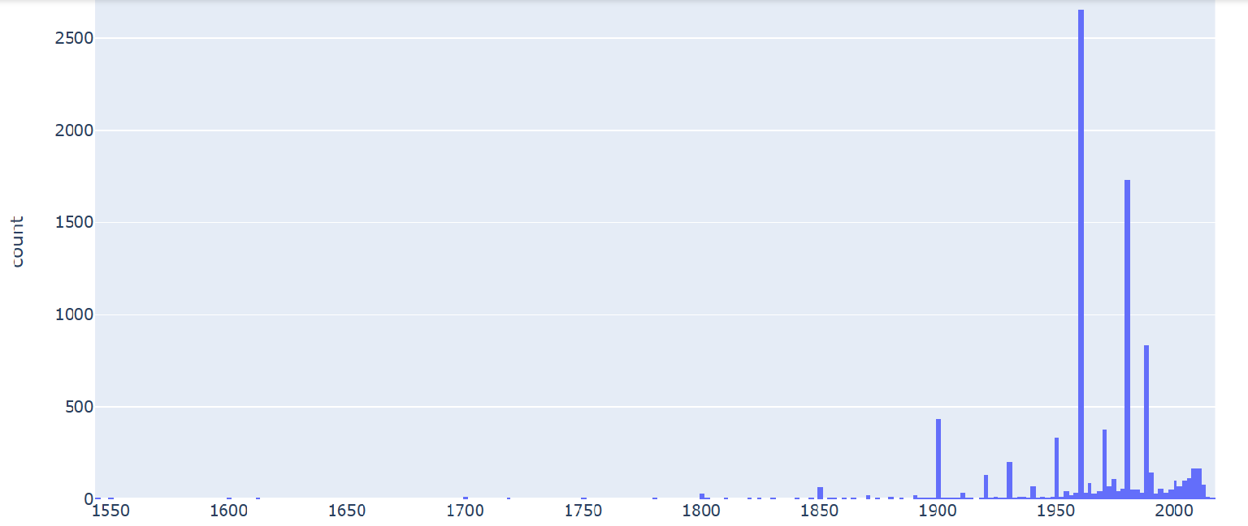

EDA-Some Meaningful insights
Building occupancy year

Slide 11
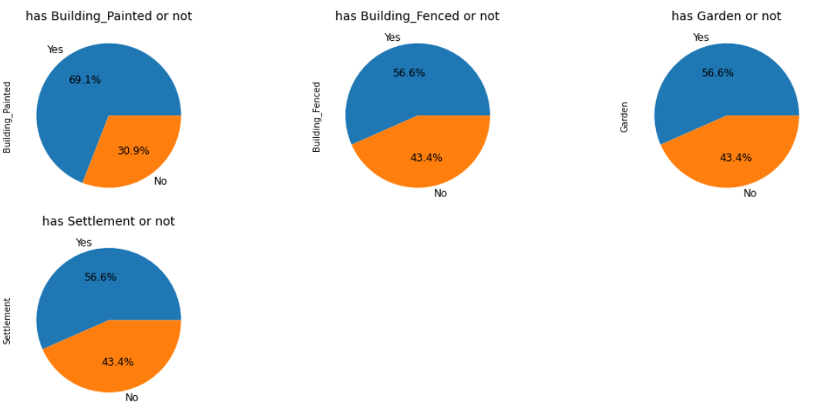
EDA-Some Meaningful insights
Bivariate and Multivariate Analysis:

Slide 12
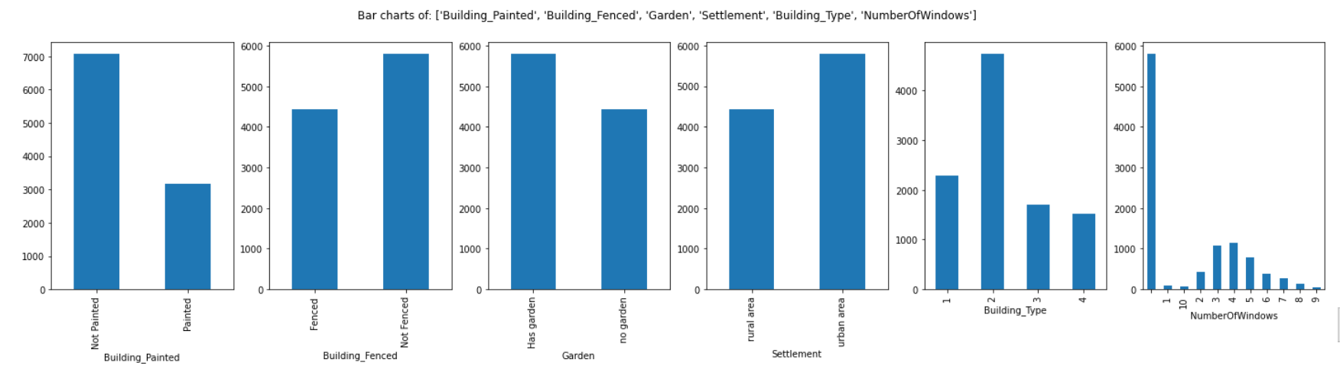
EDA-Some Meaningful insights
Bivariate and Multivariate Analysis:

Slide 13
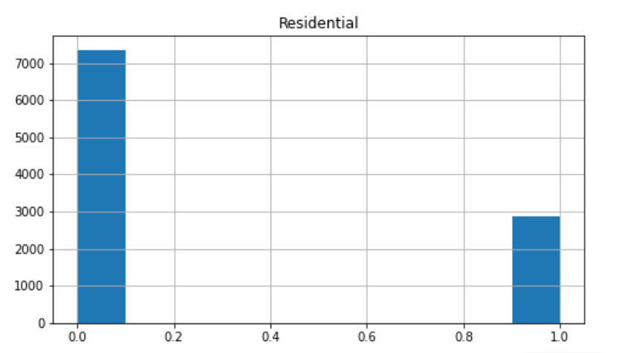
EDA-Some Meaningful insights
Bivariate and Multivariate Analysis:

Slide 14
Methodology
Area Under the Curve (AUC) was the evaluation metric used to calculate construction insurance claims.
Majority of buildings did not have insurance claims for the certain period based on calculating AUC values for each insurance client.
Logistic regression can help to estimate the probability of an insurance claim occurring such as having claim or not having claim based on a given dataset of building variables.
Gaussian Naive Bayes (GNB) is a classification technique used in Machine Learning based on the probabilistic approach and Gaussian distribution. It helps to predict the probability based on building attributes.
XGBoost is a regression predictive modeling which has better results based on four evaluation indicators namely accuracy, sensitivity, specificity, and precision.

Slide 15
Methodology
Regressor Type | Accuracy | RMSE
Logistic regression | 0.84
Gaussian Naive Bayes | 0.75
XGBOOST | 0.83 | 0.38

Slide 16
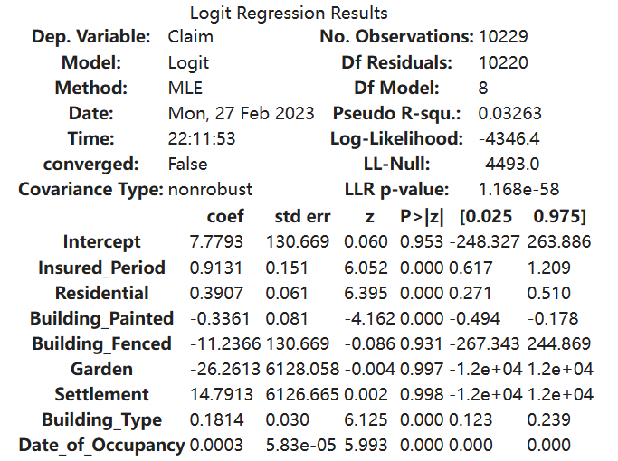
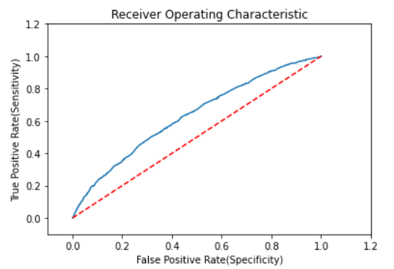
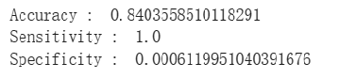
Methodology-AUC

